Slide 1
model
ETHICS PROGRAM
practices
US OFFICE OF GOVERNMENT ETHICS
COMPLIANCE DIVISION

Slide 2
helping your
INITIAL REVIEWERS
YOU
Identified potential CONFLICTS based on reported interests and job duties
Initial
Reviewer
Made sure report was turned in on-time and wasn’t outright missing pages

Slide 3
helping your
INITIAL REVIEWERS
YOU
Ensured ASSETS were reported correctly
Initial
Reviewer
Didn’t question the entry for “Various Stocks”

Slide 4
helping your
INITIAL REVIEWERS
YOU
Might need DAYS to thoroughly review a long report
Initial
Reviewer
Received, reviewed and forwarded the report to the ethics office in minutes

Slide 5
Create a GUIDE to help your first-line reviewers
Know what each asset is
Know if the employee worked on anything related to it

Slide 6
Create a GUIDE to help your first-line reviewers
Date of receipt?
Sections complete?
Assets identified?
Report signed?

Slide 7
finding your
NEW ENTRANT FILERS
Communication with HR
Supervisors failed to notify ethics office
Improperly coded in personnel system
Promotion of existing employee didn’t trigger notifications

Slide 8
Small-agency SOLUTIONS
IDENTIFY
filing positions
EXPAND
onboarding checklist
ENGAGE
human resources

Slide 9
Large-agency SOLUTIONS
IDENTIFY
filing positions
ENHANCE
onboarding reports
LEVERAGE
supervisors
TACKLE
the front end

Slide 10
effective lines
OF COMMUNICATION
General Records
Schedule 2.8
Schedule of Important
Ethics Dates
Calendar Reminders
Email Notifications

Slide 11
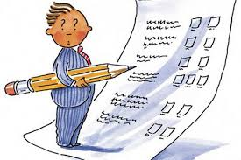
internal
ASSESSMENTS
Surveys
Internal Reviews

Slide 12
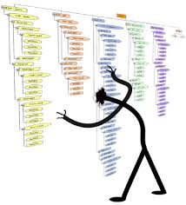
access to
LEADERSHIP

Slide 13
access to
LEADERSHIP

Slide 14
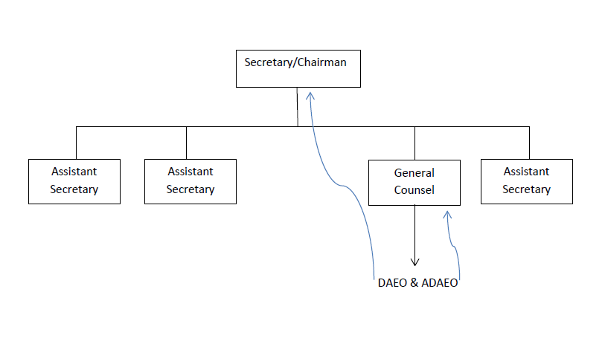
access to
LEADERSHIP

Slide 15
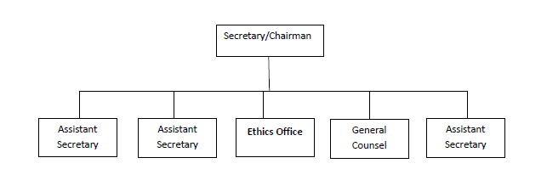
access to
LEADERSHIP

Slide 16

send ethics materials WITH OFFER LETTERS

Slide 17

make an early IMPACT

Slide 18



the key to IEO COMPLETION
Initial Ethics
Orientation

Slide 19

the key to IEO COMPLETION
Standards of Conduct

Slide 20

shared
KNOWLEDGE

Slide 21
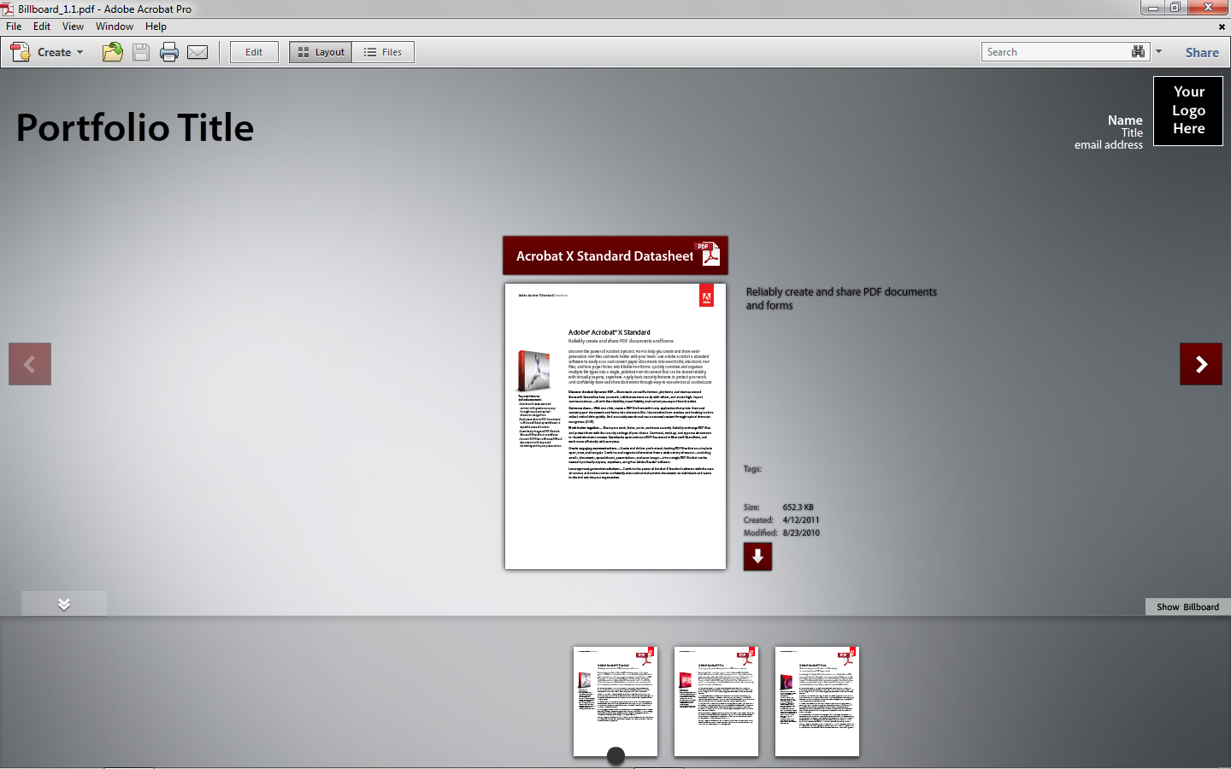
shared
KNOWLEDGE

Slide 22

shared
KNOWLEDGE

Slide 23
model
ETHICS PROGRAM
practices
US OFFICE OF GOVERNMENT ETHICS
COMPLIANCE DIVISION

